Slide 1

Buddhist and Jaina Logics, Friends or Foes?
The “Unsayable” in Reasoning
Jed Forman, Bhagwan Mallinath Assistant Professor, Loyola Marymount University
Doctoral student, Philosophy, University of Barcelona

Slide 2
Agenda
Nāgārjuna and Buddhism
Malliṣeṇa and Jainism
An attempt at Formalization
Outstanding Problems

Slide 3
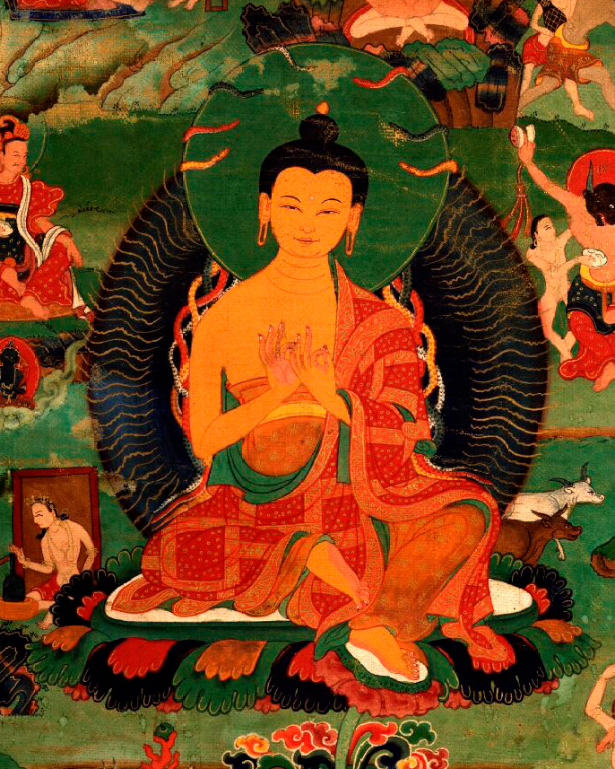
Nāgārjuna (c. 150–c. 250 CE)
“The Second Buddha”
Rejection of svabhāva, nothing has “own essence” = emptiness
Soteriology: suffering comes from believing in own essence
Uses Four Corners to exhaust possibility space for own essence
Notes:
Nagarjuna R = Reflexive, and Transitive S4
Mallisena R = reflexive, symetric, transitive, S5

Slide 4
The Four Corners
It exists (asti)
It does not exist (nāsti)
It both exists and not exists (ubhaya)
It neither exists nor does not exist (nobhaya)
Nāgārjuna rejects all four
Notes:
Nagarjuna is S4 from perspective of base
If we want to say nothing is necessary, we have to include implication by Diego’s theorem and get Reiger-Nishisimura
Denial of DNE some read double negation as conventional, discourse is consistent
Wangchuk Dorje on implication
Mallisena is S5 from everywhere
if we trade not necessary to possible, we get all of them
beause S5, we get all of them at each point (check, not quick true, but too tired now)

Slide 5
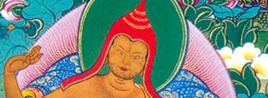
Candrakīrti (c. 600–c. 650 CE)
Rejection of First Corner Not Entailing the Second
[Opponent:] Well, even when you claim simpliciter that things do not arise from themselves, then that entails the unwanted consequence that they arise from something self. [Reply:] There is no such entailment, since a non-implicative negation (prasajya) is intended, given that arising from something else too will be negated.
nanu ca naiva svata utpannā ityavadhāryamāṇe parata utpannā ityaniṣṭaṃ prāpnoti | na prāpnoti, prasajyapratiṣedhasya vivakṣitatvāt, parato 'pyutpādasya pratiṣetsyamānatvāt | PP §21

Slide 6
Nāgārjuna (c. 150–c. 250 CE)
The Third Corner as a Composite
If suffering could be caused by either [itself or something else individually], then it could be caused by both. Suffering is not caused by something other, but nor from itself. But then how can it be causeless?
The Third Corner Represents the Jaina View (Candrakīrti)
syād ubhābhyāṃ kṛtaṃ duḥkhaṃ syād ekaikakṛtaṃ yadi |
parākārāsvayaṃkāraṃ duḥkham ahetukaṃ kutaḥ || MMK 12.9
de la tshig gal gnyis su smra ba rnams ni skye ba bdag las kyang 'gyur zhing gzhan las kyang 'gyur bas gnyi ga las skye bar sems so | MABh f. 283a.4-5

Slide 7
Nyāya Opponent
Self-Contradictory
You might say, “My statement has a nature (sasvabhāva), and by virtue of having that nature, it itself not empty. Thus, by that statement, we mean the negation of the nature of all things.”
Insufficiency
An utterance with no nature (asvabhāva) is not enough to refute natures.
sasvabhāvam etad vākyaṃ | sasvabhāvatvāc cāśūnyaṃ | tasmād anena sarvabhāvasvabhāvaḥ pratiṣiddhaḥ sarvabhāvasvabhāvo vinivarta iti || VV p. 11.11–13
tvadvacanam asvabhāvaṃ na nivartayituṃ svabhāvam alam iti | VV 1bc

Slide 8
Nāgārjuna’s Reply
If I had any thesis at all, then [given that that thesis would establish characteristics (pratijñālakṣaṇaprāptatvāt)] I would indeed have the problem you articulated earlier. But as it is, I have no thesis at all.
yadi kā cana pratijñā syān me tat eṣa me bhaved doṣaḥ |
nāsti ca mama pratijñā tasmān naivāsti me doṣaḥ || VV 29

Slide 9
Nāgārjuna (c. 150–c. 250 CE)
Unsayability (na vaktavyam)
“Empty” should not be asserted. “Nonempty” should not be asserted.
Neither both nor neither should be asserted. These are used provisionally.
śūnyam iti na vaktavyam aśūnyam iti vā bhavet |
ubhayaṃ nobhayaṃ ceti prajñaptyarthaṃ tu kathyate || MMK 22.11

Slide 10
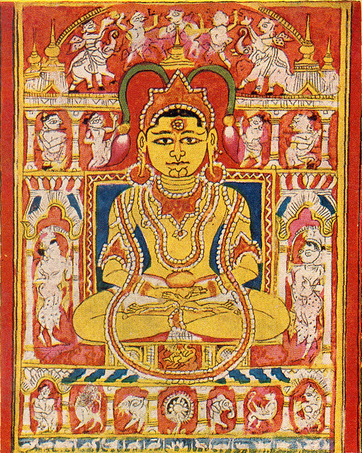
Malliṣeṇa (c. 13th cent. CE)
Important Jaina scholastic figure, attacks Buddhism
Jaina Pluralism: Elephant the Blind Man
Soteriology: The soul is both changing and permanent
“The Seven Modes”: saptabhaṅgī

Slide 11
The Seven Modes
In a way, it exists (syād-asti)
In a way, it doesn't (syād-nāsti)
In a way, it exists and doesn’t
(syād-asti-nāsti)
In a way, it is unsayable
(syād-avaktavya)
In a way, it exists and is unsayable (syād-asti-avaktavya)
In a way, it does not exist and is unsayable (syād-nāsti-avaktavya)
In a way, it exists, does not, and is unsayable (syād-asti-nāsti-avaktavya)
Jainas accept all seven
Notes:
Nagarjuna is S4 from perspective of base
If we want to say nothing is necessary, we have to include implication by Diego’s theorem and get Reiger-Nishisimura
Denial of DNE some read double negation as conventional, discourse is consistent
Wangchuk Dorje on implication
Mallisena is S5 from everywhere
if we trade not necessary to possible, we get all of them
beause S5, we get all of them at each point (check, not quick true, but too tired now)

Slide 12
Malliṣeṇa (c. 13th cent. CE)
Unsayability (avaktavyam)
When there is a desire to designate a singular object—such as the soul, or something else—with two properties, like existing and non-existing, which are posited as being simultaneously fundamental, there is no possible such word [for this], and so it is unsayable. For example, it cannot be expressed by saying “In one existing thing there are simultaneously both the qualities of existence and non-existence,” since that expression does not have the capacity to produce recognition of non-existence. Likewise, if we said “In one non-existent thing...” since that expression does not have the capacity to produce recognition of existence.
dvābhyāmastitvanāstitvadharmābhyāṃ yugapatpradhānatayā'rpitābhyāmekasya vastuno'bhidhitsāyāṃ tādṛśasya śabdasyāsaṃbhavādavaktavyaṃ jīvādistu | tathāhi sadasattvaguṇadvyayaṃ yugapadekatra sadityanena vaktumaśakyam | tasyāsattvapratipādanāsamarthatvāt | tathā'sadityanenāpi | tasya sattvapratyāyanasāmarthyābhāvāt | SVM p. 144.143–46
Notes:
Here we see artha versus dharma. The dharma is dual but the object is singular. That creates the unayabilty.

Slide 13
Malliṣeṇa (c. 13th cent. CE)
Successive v. Simultaneous
What is successive and what is simultaneous? When one wants to express a difference between the properties of existence and non-existence according to time, etc., then, since a single word cannot produce a recognition of several objects, [it is said] successively. But when the instantiated basis (atmārūpa) of those same properties occurs together in time, etc., with those properties, then, given that one word is also the means to produce the recognition of a singular property, it is possible to comprehend an object with such a nature as constituted by many additional properties. Therefore, it is simultaneous.
kaḥ punaḥ kramaḥ kiṃ ca yaugapadyam | yadā'stitvādidharmāṇāṃ kālādibhirbhedvivakṣā tadaikaśabdasyānekārthpratyāyane śaktyabhāvāt kramaḥ| yadā tu teṣāmeva dharmāṇāṃ kālādibhirabhedena vṛttamātmarūpamucyate tadaikenāpi śabdenaikadharmapratyāyanamukhena tadātmakatāmāpannasyānekaśeṣadharmarūpasya vastunaḥ pratipādanasaṃbhavādyaugapadyam | SVM p. 146.183–89

Slide 14
Malliṣeṇa (c. 13th cent. CE)
Not Completely Unsayable
But it is not completely unsayable, for in that case we could not designate it with the word "unsayable" at all.
Criticism of Nāgārjuna
Just like anything else, without something that warrants it, emptiness has no legs to establish its own position (Hemacandra)
na ca sarvathā'vaktavyam | avaktavyaśabdenāpyanabhidheyatvaprasaṅgāt | SVM p. 145.152–53
vinā pramāṇaṃ paravanna śūnyaḥ svapakṣasiddheḥ padamaśnuvīta | AVD 17ab

Slide 15
Formalizing Nāgārjuna
Criteria
Must not amount to a thesis;
even negation is unsayable_{B}
(na vaktavyam)
Rejection of the first corner cannot entail the second.
The rejection of the first and second cannot be a contradiction.
The third corner is composite.
The third corner must be distinct from the fourth.
Notes:
Nagarjuna is S4 from perspective of base
If we want to say nothing is necessary, we have to include implication by Diego’s theorem and get Reiger-Nishisimura
Denial of DNE some read double negation as conventional, discourse is consistent
Wangchuk Dorje on implication
Mallisena is S5 from everywhere
if we trade not necessary to possible, we get all of them
beause S5, we get all of them at each point (check, not quick true, but too tired now)

Slide 16
Relations to Malliṣeṇa
Criteria
The third corner represents the Jaina view.
Unsayability_{J} (avaktavyam) ≠ Unsayability_{B} (na vaktavyam)
Unsayability_{J} and the third corner qua simultaneity are logically equivalent if intensionally different.
Each of the seven modes are partial, modal.
Notes:
Nagarjuna is S4 from perspective of base
If we want to say nothing is necessary, we have to include implication by Diego’s theorem and get Reiger-Nishisimura
Denial of DNE some read double negation as conventional, discourse is consistent
Wangchuk Dorje on implication
Mallisena is S5 from everywhere
if we trade not necessary to possible, we get all of them
beause S5, we get all of them at each point (check, not quick true, but too tired now)

Slide 17

An Attempt at Formalization
Heyting Algebra as equivalent to a theory of lattices on open sets.
Rasiowa and Sikorski, 1963

Slide 18

An Attempt at Formalization
All Four Corners

Slide 19

An Attempt at Formalization
Equivalences in Heyting Algebra
If P or P* then not tierce (alpha)
van Atten, 2024

Slide 20
Formalizing Nāgārjuna
Criteria
Must not amount to a thesis;
even negation is unsayable_{B}
(na vaktavyam)
Rejection of the first corner cannot entail the second.
The rejection of the first and second cannot be a contradiction.
The third corner is composite.
The third corner must be distinct from the fourth.
Notes:
Nagarjuna is S4 from perspective of base
If we want to say nothing is necessary, we have to include implication by Diego’s theorem and get Reiger-Nishisimura
Denial of DNE some read double negation as conventional, discourse is consistent
Wangchuk Dorje on implication
Mallisena is S5 from everywhere
if we trade not necessary to possible, we get all of them
beause S5, we get all of them at each point (check, not quick true, but too tired now)

Slide 21
Relations to Malliṣeṇa
Criteria
The third corner represents the Jaina view.
Unsayability_{J} (avaktavyam) ≠ Unsayability_{B} (na vaktavyam)
Unsayability_{J} and the third corner qua simultaneity are logically equivalent if intensionally different.
Each of the seven modes are partial, modal.
Notes:
Nagarjuna is S4 from perspective of base
If we want to say nothing is necessary, we have to include implication by Diego’s theorem and get Reiger-Nishisimura
Denial of DNE some read double negation as conventional, discourse is consistent
Wangchuk Dorje on implication
Mallisena is S5 from everywhere
if we trade not necessary to possible, we get all of them
beause S5, we get all of them at each point (check, not quick true, but too tired now)

Slide 22
Problems
Logic: needs strict formal semantics and formal syntax
Exegesis: needs to be tested across textual samples
What does this get us? Is Pluralism the Dual of Quietism?
Whereof one cannot speak, thereof they should have a lot to say?

Slide 23
Thank You!
Jed Forman, Bhagwan Mallinath Assistant Professor, Loyola Marymount University
Doctoral student, Philosophy, University of Barcelona

