Slide 1

TECHNICAL FAIRNESS MEASURES IN AI SYSTEMS. Perspectives from the antisubordination approach of antidiscrimination Seminarios periódicos Del Derecho y del Revés tecnológico: diálogos entre programadores y juristas
Dra. Anna Capellà i Ricart
Prof. Lectora en Dret Constitucional
anna.capella@uab.cat

Slide 2
Summary
What is discrimination?
¿Why can decisions made though AI be discriminatory?
EU law on discrimination and AI
Technical fairness measures in AI systems
Questions

Slide 3
1.1. Anticlasfication vs. Antisubordination
Anticlassification
Antisubordination

Slide 4
1.1. Current normative
Law considers no differentiation as equality. Legal status ≠ Social status
i.e. article 9 GDPR: Prohibition of processing sensitive data.
It is permitted to justify difference of treatment
Punctual, not an epiphenomenon of a situation of subordination
Casuistic and individualized nature of judicial application

Slide 5
1.2. Types of discrimination
Direct Discrimination
Indirect Discrimination
Intersectional discrimination
Discrimination by association
Multiple discrimination
Structural discrimination
Systemic discrimination
Notes:
"The distinction between direct and indirect does not refer so much to discrimination but to the process by which it is identified or detected” (Barrère Unzueta, 1997: 74).
The legal domain has introduced two main definitions of discrimination: i) disparate treatment [11, 151]: intentionally treating an individual differently based on his/her membership in a protected class (direct discrimination); ii) disparate impact [11, 119]: negatively affecting members of a protected class more than others even if by a seemingly neutral policy (indirect discrimination).

Slide 6
1.3. Antisubordination
It is not the treatment towards an individual but the treatment towards a group of people who share one (or several) protected attribute(s) that generates discriminatory results, even if the result is individualized (and therefore a specific person is harmed).
Groups of people are the ones subject to prejudices, stereotypes and pejorative treatment. The impact of this pejorative treatment can be suffered cumulatively as a group or as an individual.

Slide 7
1.4. Affirmative action
Action aimed at favouring access by members of certain social groups, to rights which they are guaranteed, to the same extent as members of other social groups.
Measures aimed at a specific group, intended to eliminate and prevent discrimination or compensate for disadvantages resulting from existing attitudes, behaviors, and factual structures
The protected attribute must be taken into account to deploy these measures
Examples: gender or disabled people quota, campaigns to promote STEM careers among girls and teenagers

Slide 8
1.5. Reverse discrimination
Treatments that cause harm to people who belong to dominant or majority social groups precisely because of they belong to these groups.
The person that suffers the reverse discrimination does not feel the duty (neither moral nor legal) to pay with his case the consequences of the measures established to fight against group discrimination.
From the perspective of antisubordination this is not a case of discrimination.
The prejudice is of another kind.
Students for fair admissions, INC. v. President and fellows of Harvard College (2023)

Slide 9
2. ¿Why can decisions made though AI be discriminatory?
We live in an essentially unequal society
Technical measures
Datasets
Subjective variable classification
Human appreciations
Masking
Instrumentalising the decision made through the algorithm
Underestimation based on historical data
Through proxies
No representative
Decontextualised
Human bias in data labelling

Slide 10

2.1. What can we learn from discriminatory AI systems
Discrimination is not punctual, is systemic.

Slide 11
3. EU law on discrimination and artificial intelligence
EU Antidiscrimination law
EU General Data Protection Regulation
EU Artificial Intelligence Act
Art. 19 Treaty on the Functioning of the European Union (take action)
Art. 21 Charter of Fundamental Rights of the European Union (prohibition)
Directive 2000/43/CE; Directive 2000/78/CE; Directive 2004/113/CE; Directive 2006/54/CE…
Art. 5.d (personal data should be accurate)
Data subject rights (Art. 15-22)
Art. 13.2.f, 14.2.g y 15.1.h RGPD (information to the data subject)
Recital 71 (automated processing should include specific information to the data subject; technical and organisational measures to correct inaccuracies)
Article 9 (prohibition to process special categories of data)
Art. 22 (right to not to be subject to solely automated decision making)
Art. 10 (obligations regarding data quality) Art. 10.5 (enabling to process special categories of data to detect and correct biases
Article 86 (right to obtain clear and meaningful explanations)
Art. 1 (ensure a high level of protection of fundamental rights)
Protection according to risk (prohibited, high risk, systemic risk, transparency obligations)
Article 27 (Fundamental rights impact assessment for high-risk AI systems)
Article 57 (sandboxes)
Article 71 (public database)
Positive action
Annex IV (Technical documentation relating potential discriminatory impacts (2.g)
Article 77 (power to request and access any documentation created or maintained under this Regulation by National public authorities or bodies)
Notes:
Article 22 GDPR: The data subject shall have the right not to be subject to a decision based solely on automated processing, including profiling, which produces legal effects concerning him or her or similarly significantly affects him or her.
Recital 71 GDPR: technical and organisational measures appropriate to ensure, in particular, that factors which result in inaccuracies in personal data are corrected and the risk of errors is minimized
Article 86 AI Act: right to obtain from the deployer clear and meaningful explanations of the role of the AI system in the decision-making procedure and the main elements of the decision taken.

Slide 12
3.1. Gaps in EU regulations
EU Antidiscrimination Law
Equidistance – Reverse discrimination
Affirmative action only in relation to certain protected attributes
Different scope of application of EU antidiscrimination directives (labour; welfare and social protection, access to goods and services...)
Need of evidences of prima facie discrimination
Opacity (how to compare your case with other cases?)
Exclusion
Responsibility?
Companies, organizations, or individuals who develop the system, establish its objectives, make decisions related to it, ensure its operation, or use it.
Consideration of categories without intersectional perspective
A single protected attribute?
Exact attributes that led to discrimination?

Slide 13
EU General Data Protection Regulation
“special category”
Inefficiency of data subject’s rights. Ex: rectification or erasure
Aslam, I. Situating and understanding machine unlearning ethically, EWAF 2025
Issues regarding the right to explanation
EU Artificial Intelligence Act
Discrimination is perceived as assumable.
It does not establish concrete results or the obligation to prove that the system does not magnify existing structural discrimination.
Providers’ self assessment of high-risk systems requirements
Issues regarding the right to explanation
Proposal for a Regulation for the simplification of the implementation of harmonised rules on artificial intelligence (Digital Omnibus on AI) (19/11/2025)

Slide 14
4. Technical fairness measures in AI systems
Technical Measures
When?
Modifies biased data (pre-processing algorithms),
Adds a fairness constraint directly to a model’s objective function (in-processing algorithms),
Modifies a biased model’s outcomes (post-processing algorithms).
Destinataires?
Among individuals
Among social groups

Slide 15
4.1. Destinataires?
Algorithmic individual fairness: This means the algorithm’s decision is not affected by group membership but only by the relevant characteristics of an individual (anticlassification).
“similar predictions in similar individuals”
Limitations:
what constitutes “similar individuals”?
Reliance on learning similarity metrics from data = encoding existing biases
Algorithmic group fairness: Parity of statistical metrics across groups that differ in a protected attribute (i.e. male and female groups)
“property that it performs equally well on a metric across protected groups”
Fairness with respect to the whole group
Limitations:
Multiple groups with overlapping memberships or complex relationships
Anderson, J. W. and Visweswaran, S. (2025) Algorithmic individual fairness and healthcare: a scoping review, JAMIA Open, 8(1). https://doi.org/10.1093/jamiaopen/ooae149

Slide 16
4.2. When?
Pre-processing algorithms
i.e. modifying the features in the dataset making it more difficult for the algorithm to differentiate between the two groups
In-processing algorithms
i.e. prediction error of all groups remain below a predefined level
Post-processing algorithms
i.e. flipping some decisions of a classifier
How can this work if even though there are biased training datasets?

Slide 17
4.3. Academic articles claim to achieve fairer outcomes through different measures
Demographic parity or statistical parity
Equalized odds
Overall Accuracy Equality
Predictive Parity
Equal Calibration
Conditional Statistical Parity
Predictive Equality
Conditional Use Accuracy Equality
Treatment Equality
Balance for the Positive Class
Balance for the Negative Class
Fairness through Unawareness
Mutual Information
Mean Difference

Slide 18
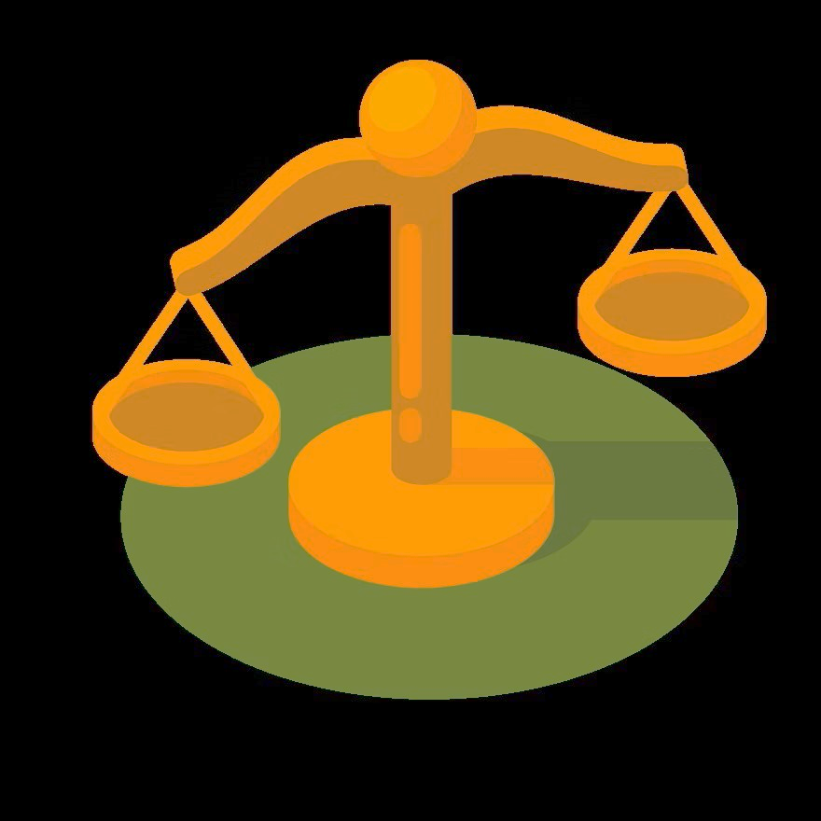
4.4. Trade-offs
Between fairness measures
i.e. Equalised accuracy and equalised odds
COMPAS: Equal accuracy of positive predictions; not equal odds to have a positive prediction
Between fairness and accuracy
Fairness through unawareness
Less data, less accuracy

Slide 19
4.5. Problems
Yao, Zhou, Li, Han, Liu (2024). Understanding fairness surrogate functions in algorithmic fairness:
“The source of algorithmic unfairness is multifaceted. Therefore, fairness researchers may have to identify the source of unfairness on a case-by-case basis and address it accordingly instead of proffering a one-size-fits-all solution”.
Pessach and Shmueli (2023) Algorithmic Fairness:
Proliferation of definitions and measures, fairness-related datasets, and fairness-enhancing mechanisms.
Evaluation of the effectiveness of these mechanisms? Which mechanisms should be used for comparison?
“It seems that biased algorithms are easier to fix than biased humans or procedures”

Slide 20
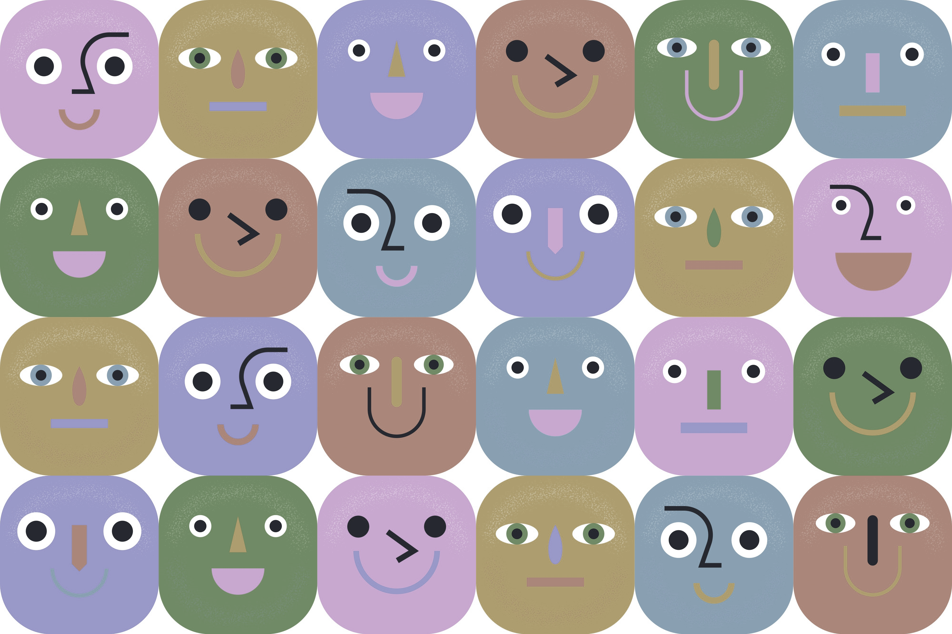
4.6. Accuracy ≠ Equality
Just because the AI system give more precise results according to each social collective does not mean that it is not discriminatory…
…or that it should be used.
Ex. Facial recognition:

Slide 21
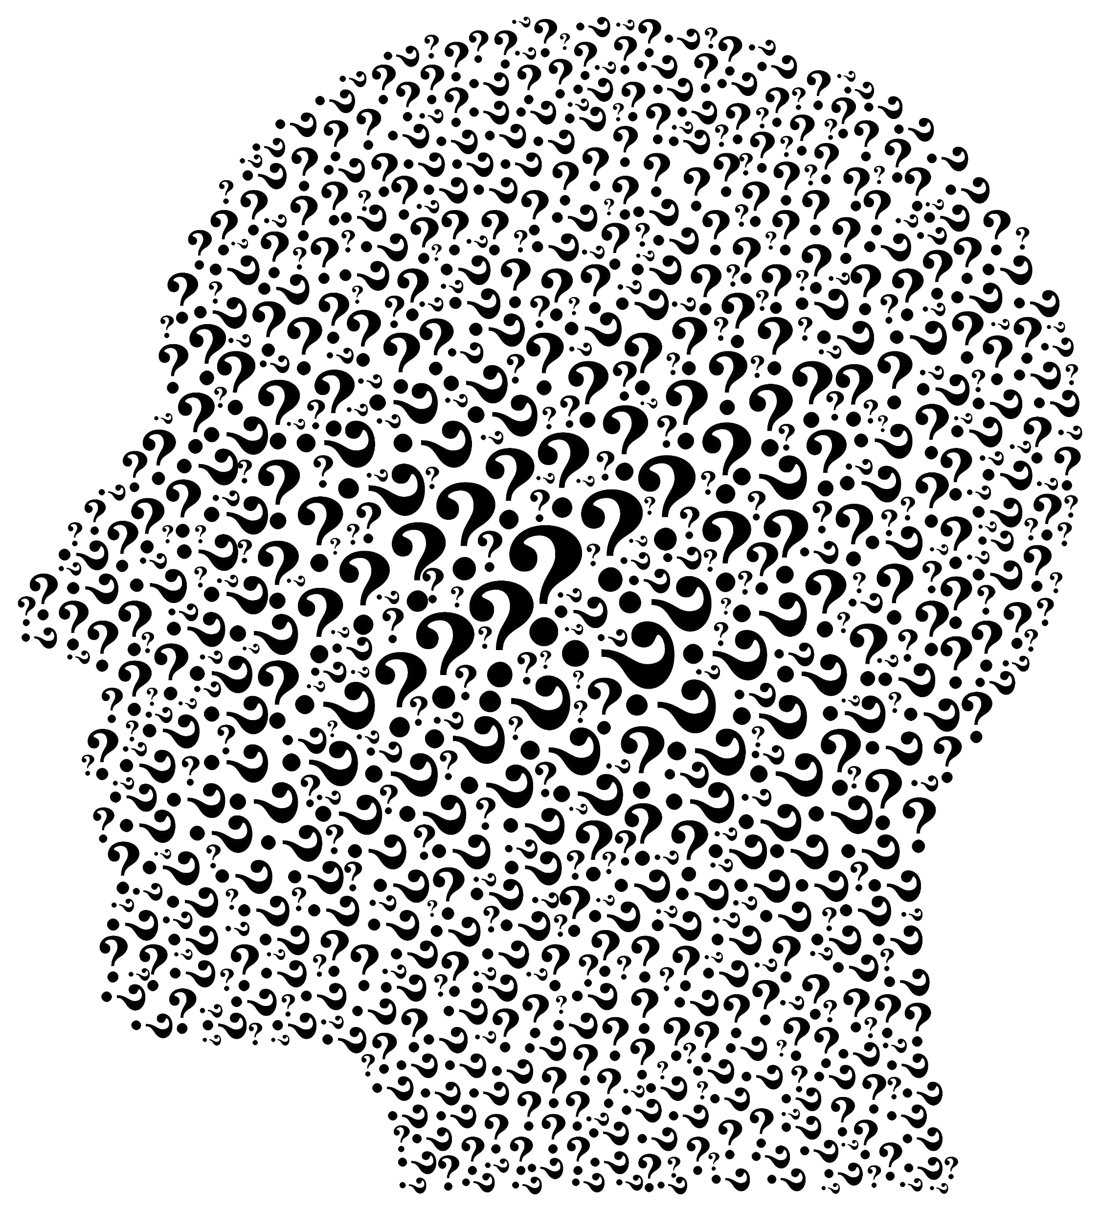
Questions
Aim:
Fairness washing?
That algorithmic systems are just as discriminatory as society?
That algorithmic systems are less discriminatory than society?
Who determines to what extent? Building on what standards? Are these interventions determining what is fair, without debate?
Some of the measures have as a consequence the benefit for some individuals or groups in expenses to other individuals or groups (that would have been treated better by the algorithm in the event there had not been any intervention).
Is this permitted affirmative action, or not?
Expectation:
Are these measures really effective?
To what extent these measures are effective when the algorithm evolves (or keeps learning)?
Have these measures limited (and also unexpected) effects?
The measures proposed by the doctrine only have an impact on a concrete decision point, disregarding structural causes and effects.
These measures are performed mostly by engineers (interdisciplinarity?).

